Slide 1
Week 4 notes
Moving from literature survey to the design of experiments

Slide 2
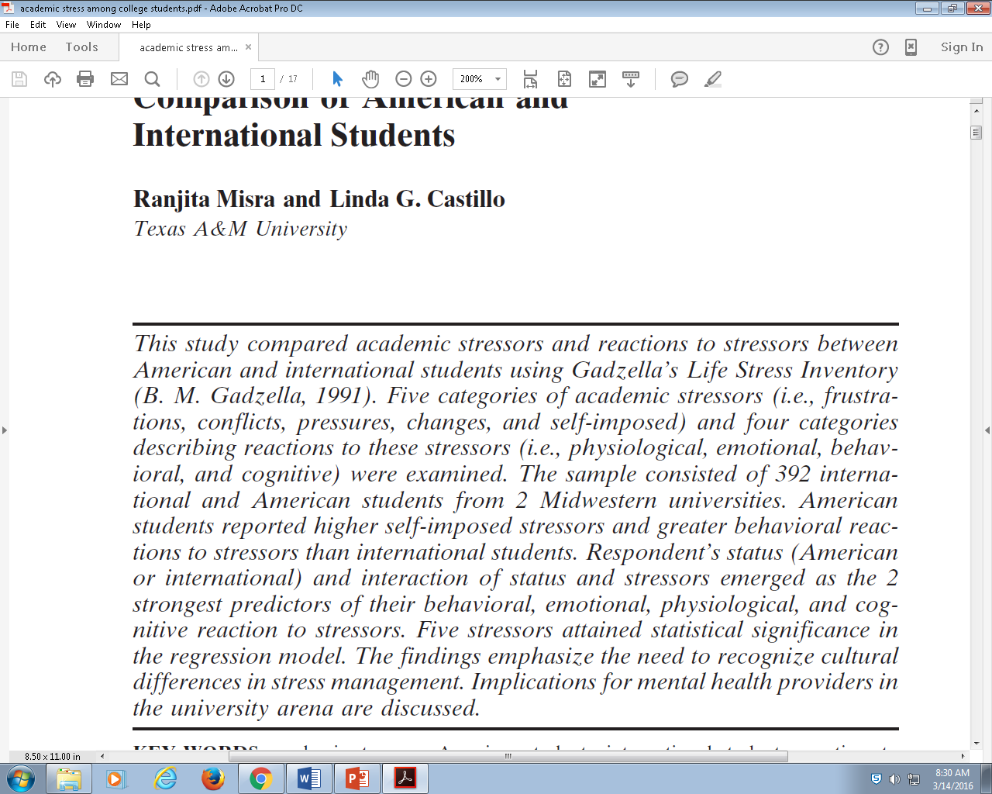
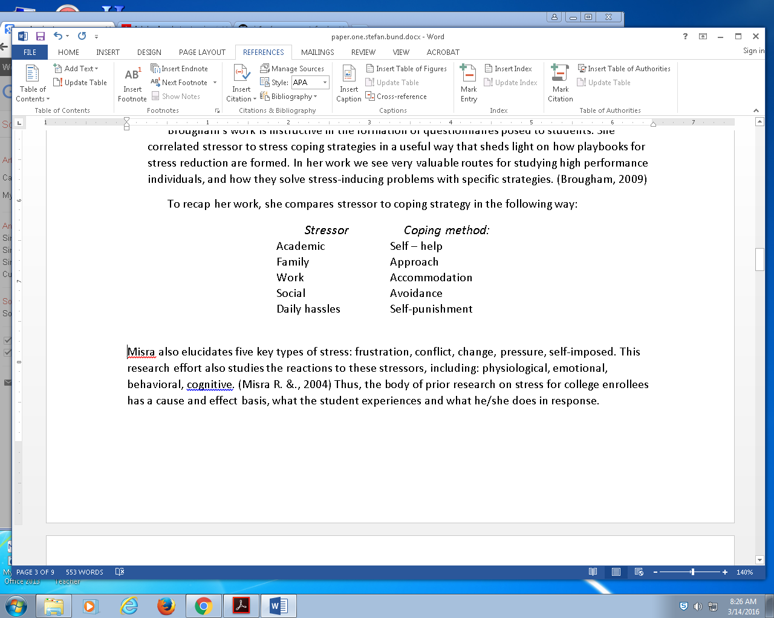
Summarize our final piece of literature: misra

Slide 3
Most college level research takes three phases
Lit survey
Design of experiments (DOE)
Executing some new experiment
Delivers new knowledge
Publishing comes next (spirit of the paper)

Slide 4
Lit survey
Summarizes the landscape of knowledge, in your domain / specialization

Slide 5
Design of experiments
Looks for opportunities to learn new things
Acknowledges holes in the academic record
Ack things which are not known
Proposes a strategy for attaining new domain knowledge
Domain = topic, specialization

Slide 6
What do we know?
History of the topic deals with gender, nationality
Types of stress
Types of solutions to stress

Slide 7
What do we want to know? What fascinates us?
Gender? No
Nationality? Not so much
Playbook, how to solve and mediate stress the best – this is much more vital / interesting
Look at the connections between types of stress and their solution, how to be a “stress master”
We want to know how to manage and deal with stress better than anyone
So we can say “stress = no problem”

Slide 8
Stress playbook
How do you cope with types of challenge, or stress?
Devise a toolkit for learning how the most successful people deal with their challenges

Slide 9
http://goo.gl/forms/uRpYSgFuVH

